Slide 1

Department of Computer Science and Engineering Interdisciplinary Project
RICE CLASSIFIER
Project Students Guide
NIKHIL SAMUEL JOSEPH J Dr. T. JUDGI
41110881 Associate Professor, CSE

Slide 2
Presentation Outline
Introduction
Objectives
Abstract
Literature Survey
Existing Availabilities
Proposed application
Novelty
Hardware and Software Requirements
Ideation Map
Application Snapshots
Conclusion
References

Slide 3
Introduction
This an introduction to the project that I have been making for my PRIDE Certification through the company Cognibot for Machine Learning domain.
RICE CLASSIFIER is the name of the online we application that I have made using web development tools and programming languages to create ML models and host those models at a given point of time.
The following slides shows the in depth description of my product.

Slide 4
Objectives
Enhance Learning: To provide a tool that enhances the learning experience by offering different ML models like Logistic Regression, Decision Tree, Random Forest Classification models .
Train and Validate the Model:
Once you’ve selected an ML model, the next step is to train and validate it using relevant datasets.
Utilize frameworks scikit-learn to train and fine-tune the model.
Validate the model using appropriate evaluation metrics to assess its effectiveness in real-world scenarios.
Deploy the Model:
After training and validating the ML model, deploy it into a production environment where it can serve predictions in real time.
Choose a deployment strategy that suits your website’s architecture (on-premises, cloud-based services, or containerization technologies like Docker).
Ensure seamless integration with your website’s backend infrastructure.

Slide 5
Abstract
In today's rapidly evolving AI landscape, the role of Machine Learning has helped in evolving the AI technology for future development. Machine learning models are powerful algorithms that can identify patterns, make predictions, and uncover insights from vast datasets. Unlike rule-based programs, ML models evolve over time as new data enters the system. In this dynamic field, we explore supervised and unsupervised learning, select appropriate algorithms, preprocess data, train models, evaluate performance, and deploy them for real-world decision-making. ML models revolutionize problem-solving across domains, enabling accurate predictions and informed actions. I will be creating a classification models using different algorithms to see how models are chosen correctly and are created to get the best possible result.

Slide 6
LITERATURE SURVEY
YEAR | AUTHOR & JOURNAL NAME | INFERENCE
JULY 2022 | RICE VARIETIES CLASSIFICATION USING MACHINE LEARNING ALGORITHMS BY PRANSHU SAXENA , KANU PRIYA , SACHIN GOEL , PUNEET KUMAR AGGARWAL , AMIT SINHA , PARITA JAIN | THIS RESEARCH FOCUSED ON DEVELOPING A MACHINE LEARNING MODEL FOR MANY DIFFERENT ALGORITHMS.
JUN 2021 | CLASSIFICATION OF RICE VARIETIES WITH DEEP LEARNING METHODS BY MURAT KOKLU, ILKAY CINAR, YAVUZ SELIM TASPINAR | THIS RESEARCH FOCUSED ON DEVELOPING A DEEP LEARNING MODEL FOR MANY DIFFERENT NEURAL NETWORK ALGORITHMS.
SEP 2019 | CLASSIFICATION OF RICE VARIETIES USING ARTIFICIAL INTELLIGENCE METHODS BY ILKAY CINAR, MURAT KOKLU | THIS RESEARCH FOCUSED ON DEVELOPING A MACHINE LEARNING MODEL FOR ALGORITHMS LIKE LR, MLP, SVM, DT, RF, NB AND K-NN.

Slide 7


Existing Availabilities
PyTorch is an open-source deep learning framework that combines the machine learning library of Torch with a Python-based high-level API. Developed by Facebook’s AI research lab (FAIR), PyTorch is widely used for building neural networks in fields like computer vision and natural language processing. It provides flexibility, ease of use, and powerful tools for training and deploying models
TensorFlow is an open-source machine learning library developed by Google. It serves as an end-to-end platform for creating and deploying machine learning applications. TensorFlow empowers us to harness the power of deep learning models, making complex tasks accessible and efficient

Slide 8

Proposed Application
The online quiz application is created so that so that any user can test our Machine Learning models
It also has the capability to predict the type of rice used based on given input
It also shows output for all the different Machine Learning models.

Slide 9
Novelty
In my web application three Machine learning models are used. They are Logistic Regression, Decision Tree, Random Forest Classification models .
So by entering values , we can predict the type of rice and how the values are predicted on all the three models.

Slide 10
Hardware and Software Requirements
Hardware:
Processor : Minimum 1 GHz ; Recommended 2 GHz or more
Internet Connection
Hard drive : Minimum 24 Gb ; Recommended 64 Gb or more
Memory : Minimum 1Gb ; Recommended 4 Gb or more
Software:
Python: Python is the leading language for ML due to its simple syntax, readability, and extensive libraries. It supports various ML frameworks and tools. Popular Python libraries for ML include:
Scikit-Learn: A versatile library for machine learning tasks such as classification, regression, and clustering.
It is helpful for basic ML model creation.
Pandas: An open-source Python library used for data manipulation and analysis. It simplifies tasks related to structured data, making it well-suited for working with tabular data, spreadsheets, and SQL tables.

Slide 11
Software Requirements
NumPy: An open-source Python library used for working with arrays. It also provides functions for linear algebra, Fourier transform, and matrix operations. NumPy was created in 2005 by Travis Oliphant and stands for Numerical Python.
Jupyter Notebook: An interactive web-based environment that combines code, visualizations, and narrative text, making it ideal for data analysis, machine learning, and scientific computing.
Gradio: An open-source Python library used to create machine learning (ML) and deep learning (DL) web applications. It offers a user-friendly interface that allows developers to build and deploy interactive and customizable interfaces for their machine learning models quickly.
GitHub: GitHub is a web-based platform for version control and collaboration, widely used by developers to manage and share code repositories, track changes, and collaborate on software projects. It provides tools for code hosting, issue tracking, and continuous integration, among other features.

Slide 12
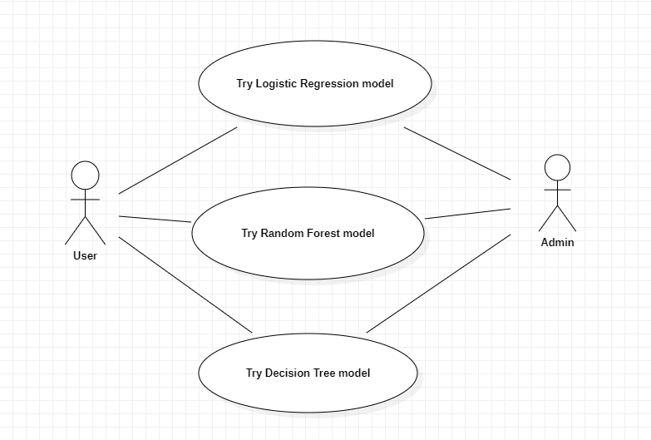
Ideation Map

Slide 13
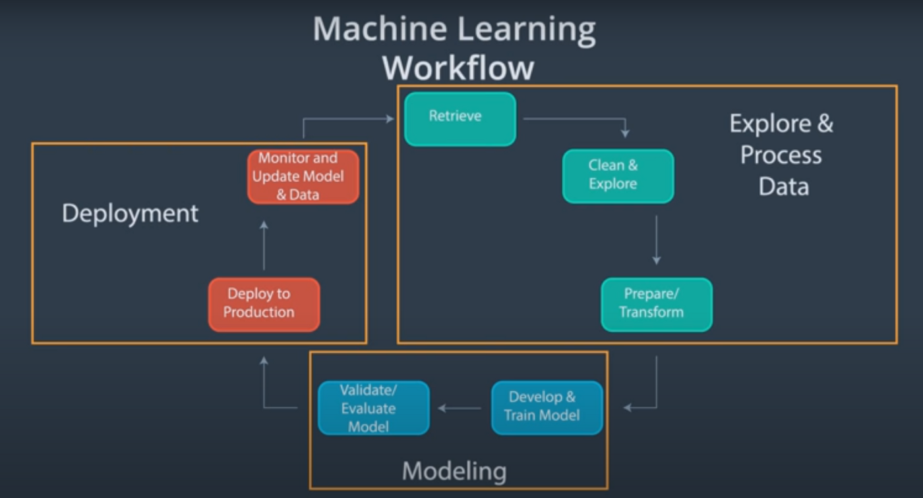
Ideation Map

Slide 14
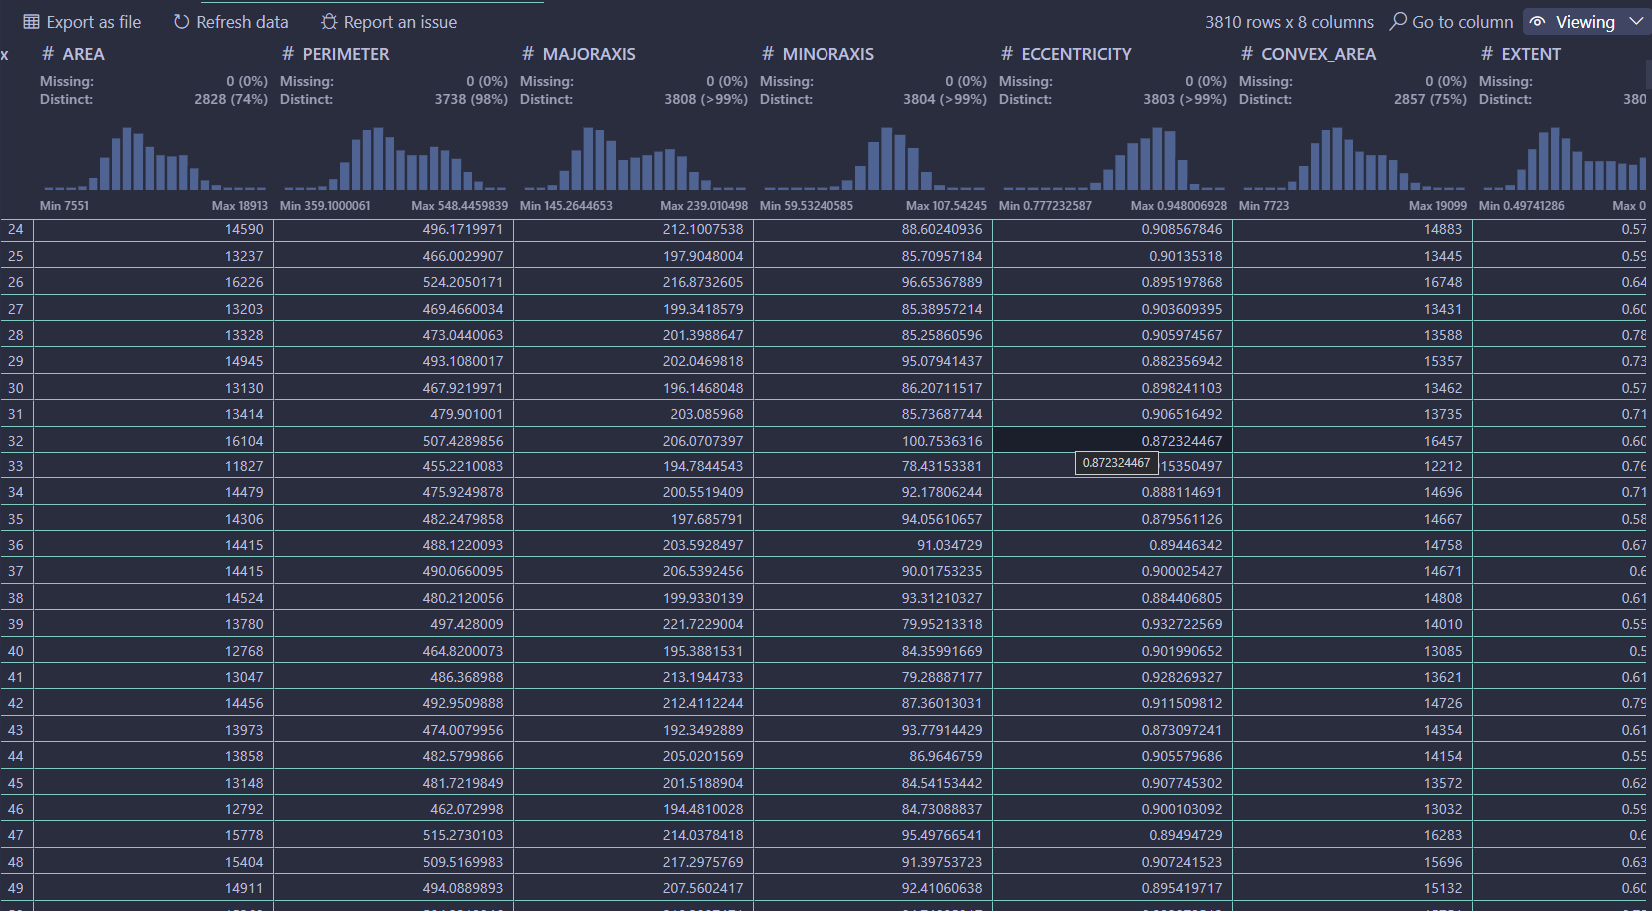
Application Snapshots
Data Wrangler data display

Slide 15
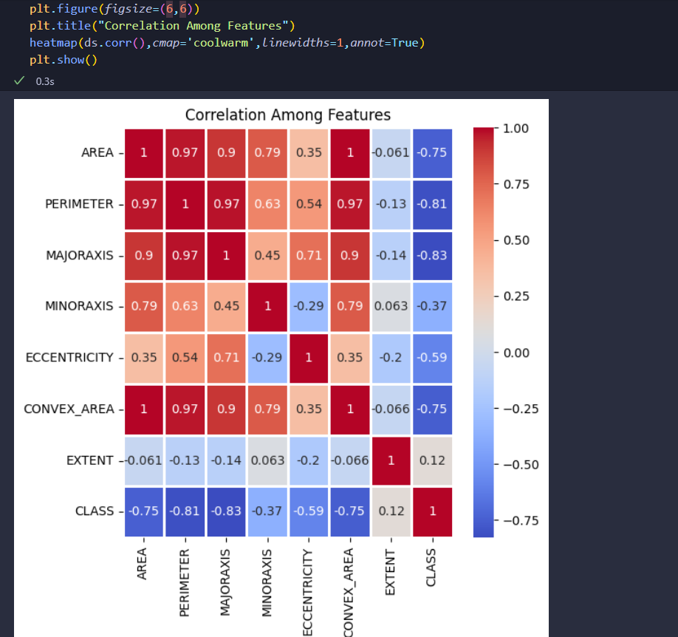
APPLICATION SNAPSHOTS
Correlation among features

Slide 16
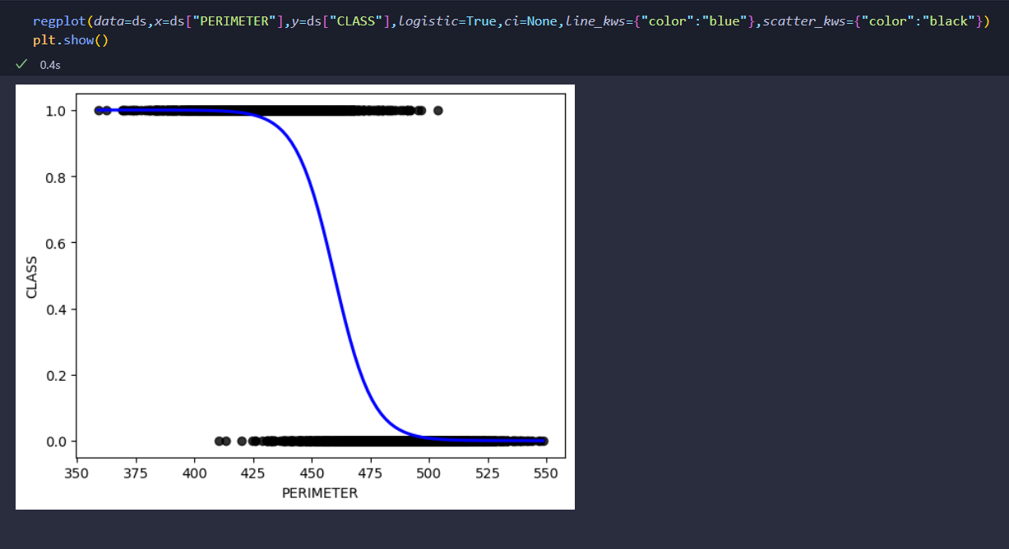
Application Snapshots
Logistic regression plot

Slide 17
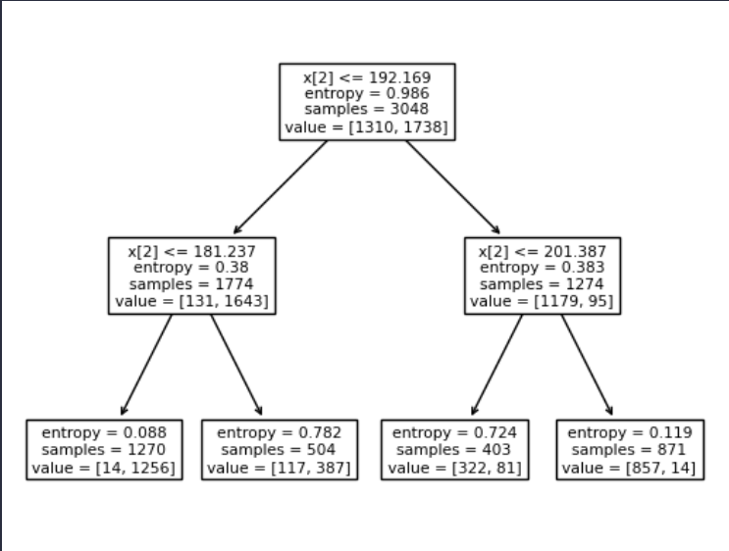
Application Snapshots
Decision Tree

Slide 18
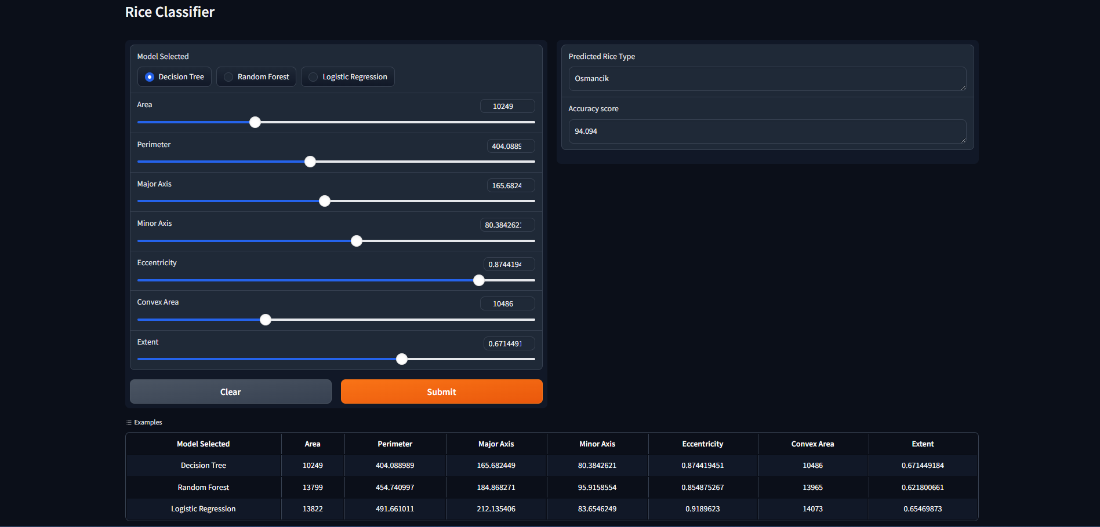
Application Snapshots
Web Application

Slide 19
References
Source Code GitHub Link : PRIDE Project

Slide 20
THANK YOU

